Slide 1
Activating Big Data for Active Transportation with a Statewide Data Platform
Laura Schewel
CEO, StreetLight Data
laura.schewel@streetlightdata.com
Notes:
At 10:01 AM: Hello everyone, and thanks for joining today’s webinar. My name is [NAME] and I am [TITLE] at StreetLight Data. We’ll give folks a few minutes to join before we get started.
At 10:05AM: Thanks again for joining today’s webinar. For those of you that just joined, my name is [NAME], and I am [TITLE.]

Slide 2
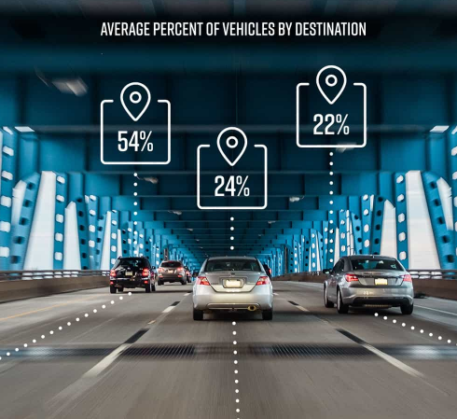
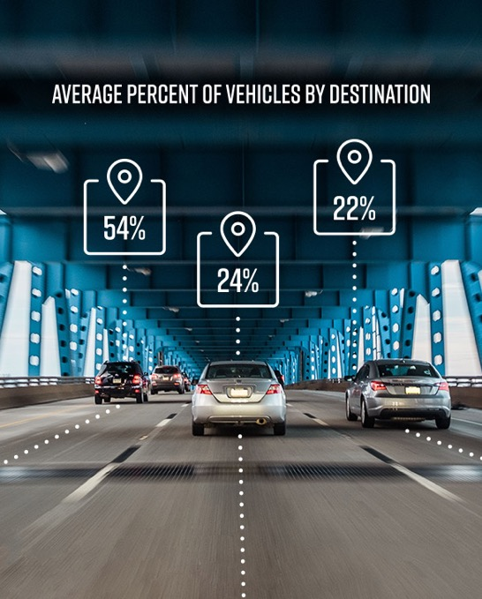
We process trillions of geospatial data points to measure how pedestrians, bikes and vehicles interact.
Measure mobility for any road or zone in a few clicks
Deploy the right infrastructure in the right place
Use big data to manage New Mobility solutions

Slide 3
What Big Data are we working with?
Mobile device data from ~23% of US and Canadian adults and ~12% of commercial truck trips.
Video shows a subset from Oct 8th, 2017 in San Bernardino, California.
Notes:
As you all know, Big Data is a Big Buzz Word right now. And Big Data is pretty cool. At StreetLight, we’ve got a lot of it. This video is showing you a sample of 24 hours in San Bernardino. The purple dots are smart phones with apps pinging locationally in the background. This data comes to us deidentified and it’s all opted in, to protect privacy. The orange dots are from GPS management devices in commercial trucks. Throughout the data, activity rises and falls in various parts of the city. We mix this data with all sort of other more conventional data, and I”ll give your more details later if you like.
And this video is very pretty and fun to watch. But it’s not actually useful. Because it’s just a pile of data, albeit a pretty animated pile. Big Data alone is NOT useful.

Slide 4
Group Points into Mode-Assigned Trips Using Machine Learning
From: NREL, mode-specific apps. “I’m walking! I’m walking! I’m walking!”
Walk 80%
Walk 90%
Walk 80%
Walk 60%
Walk 50%
Walk 20%
Walk 20%
Sta. 20%
Bike. 10%
Sta. 20%
Sta. 40%
Sta. 50%
Sta. 80%
Sta. 80%
Notes:
ML Trade off – less clear what the breaking criterea is

Slide 5
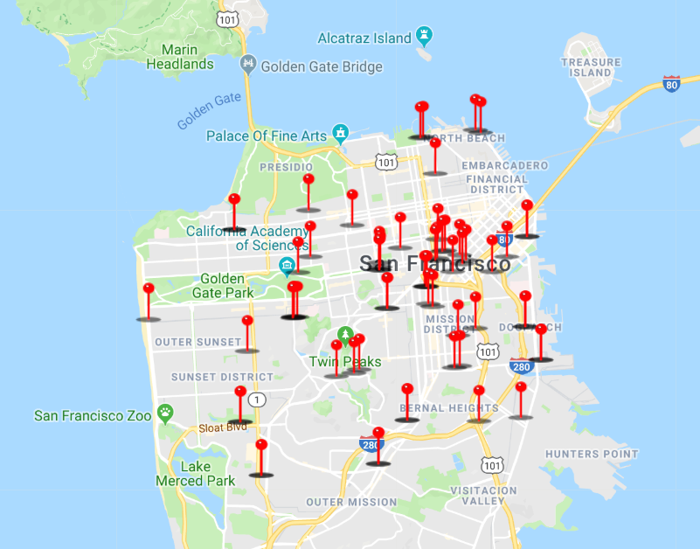
Validation – Compare to Permanent Counters San Francisco Municipal Transportation Agency (SFMTA)
Locations of SFMTA Permanent Bike Counters
R² between StreetLight’s sample counts and SFMTA bike counter counts is 0.81 for weekdays (Month Matched)

Slide 6
Section II
What is available for bike and pedestrian modes?

Slide 7
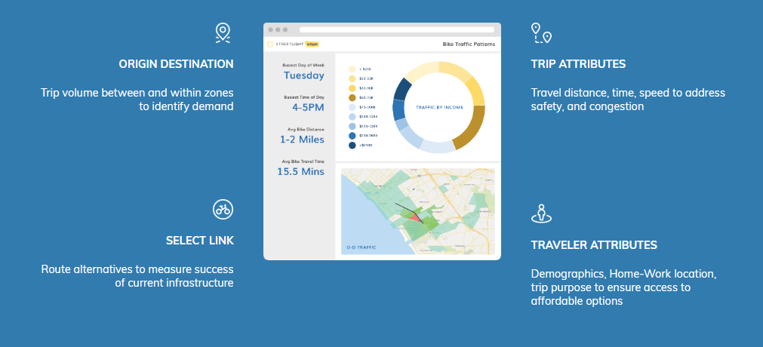
Which Bike and Pedestrian Metrics?
Notes:
As you all know, Big Data is a Big Buzz Word right now. And Big Data is pretty cool. At StreetLight, we’ve got a lot of it. This video is showing you a sample of 24 hours in San Bernardino. The purple dots are smart phones with apps pinging locationally in the background. This data comes to us deidentified and it’s all opted in, to protect privacy. The orange dots are from GPS management devices in commercial trucks. Throughout the data, activity rises and falls in various parts of the city. We mix this data with all sort of other more conventional data, and I”ll give your more details later if you like.
And this video is very pretty and fun to watch. But it’s not actually useful. Because it’s just a pile of data, albeit a pretty animated pile. Big Data alone is NOT useful.

Slide 8
Section III
Examples of Multimode Solving
Active Transportation Problems

Slide 10
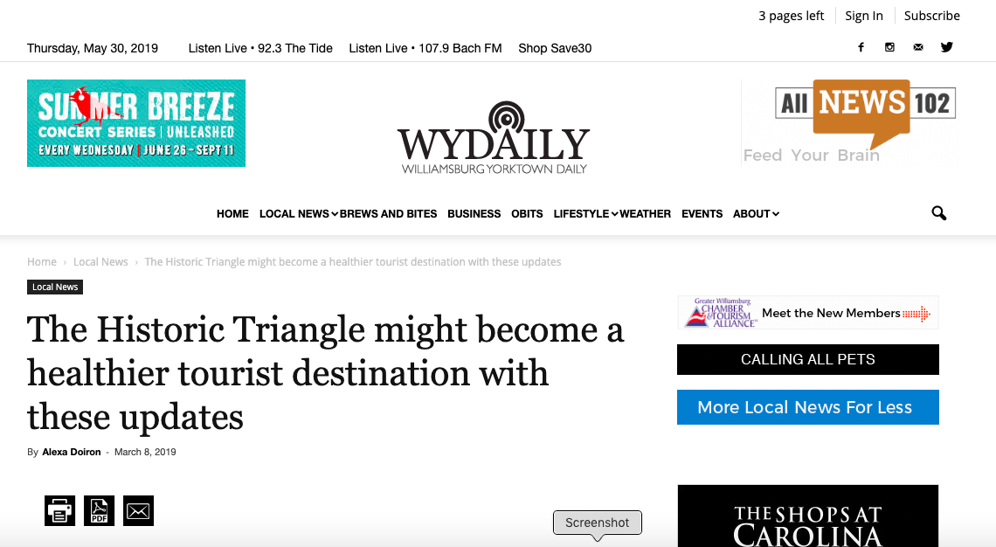
HRTPO wins funds by showing tourist attraction of bike lanes
“This is a very powerful tool because it lets us know where people are coming from and going to,” said Robert Case, chief transportation engineer with HRTPO. “We could take that data and find that half the people are not from this area and so they’re bringing money from outside and spending it in Hampton Roads.”

Slide 11
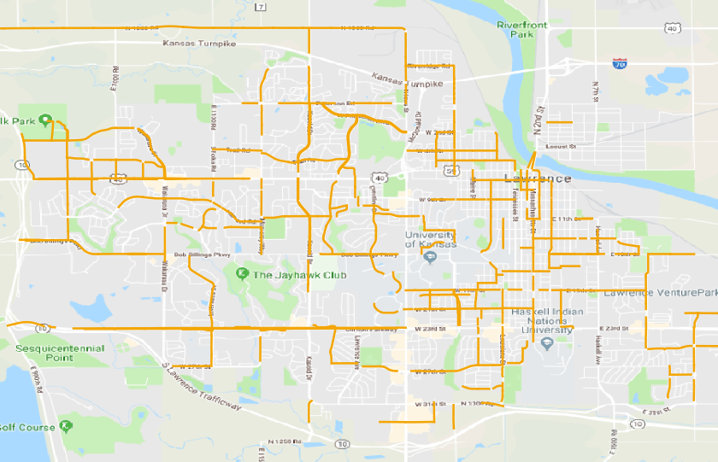
Lawrence, KS Existing Bike Lanes

Slide 12
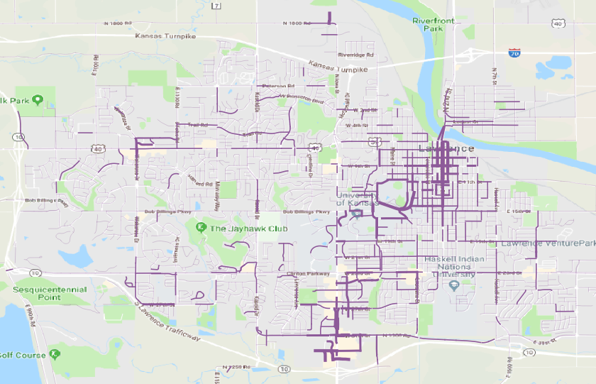
Lawrence, KS Relative Bike Volumes (from StreetLight InSight)

Slide 13
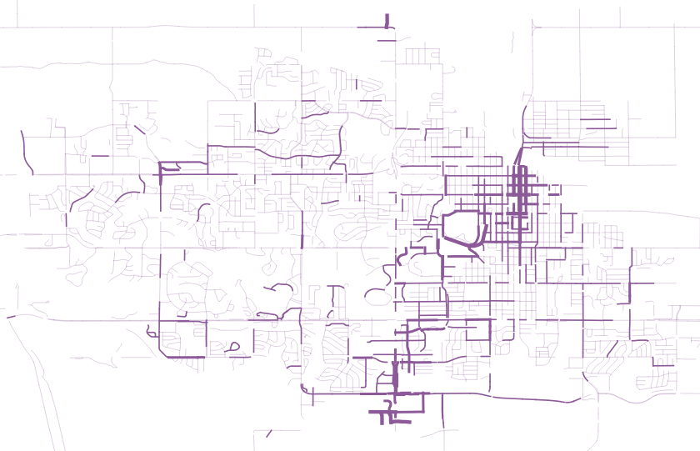
Lawrence, KS Relative Bike Volumes (from StreetLight InSight)

Slide 14
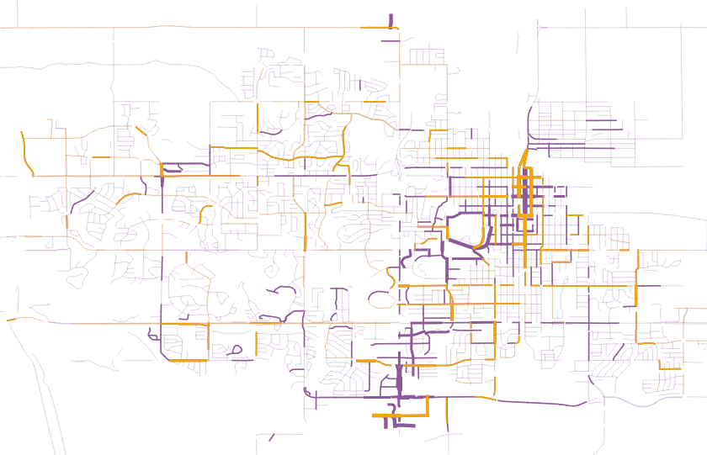
Lawrence, KS Relative Bike Volumes (from StreetLight InSight) Bike lane No bike lane (maybe a sharrow)

Slide 15
Caltrans Project Prioritization

Slide 16
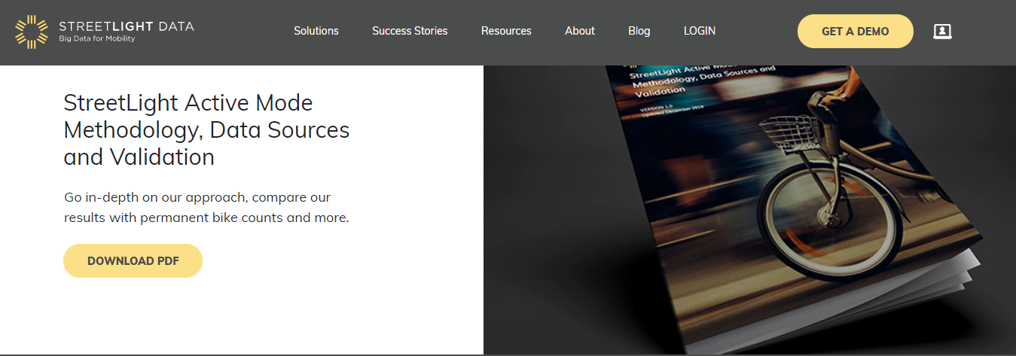
streetlightdata.com/bike-pedestrian-analytics

Slide 17
info@streetlightdata.com

